Slide 1
House Prices Data Analysis
By Krishna Deshpande

Slide 2
Data Set
Had used a smaller dataset before which caused overfitting in all the models I tried.
Once I identified the problem I rectified it using a different and bigger dataset
Dataset was taken from Kaggle
Data set access link : https://www.kaggle.com/datasets/camnugent/california-housing-prices/download?datasetVersionNumber=1

Slide 3
Steps Followed in this task
Data Preprocessing
Exploring the given data and Visualization of it
Data Modeling
Model Optimization

Slide 4
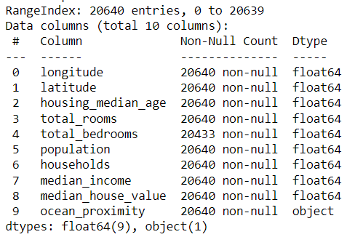
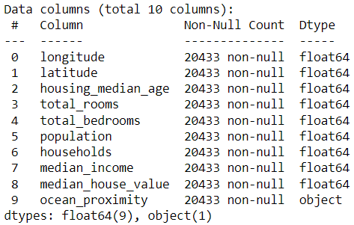
Step 1: Data Preprocessing
By using data.info(), we understood that we have a few values missing.
We used the below code to make all of the data be similar. data.dropna(inplace=True).

Slide 5
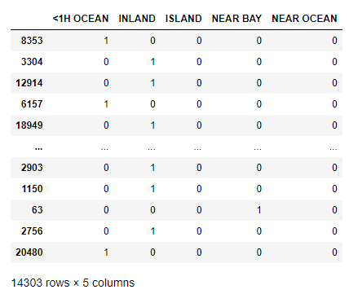
Step 1: Data Preprocessing
We can’t process objects so we replaced them with 0’s and 1’s by the below process.
data=data.join(pd.get_dummies(train_data.ocean_proximity)).drop(['ocean_proximity'], axis=1)

Slide 6
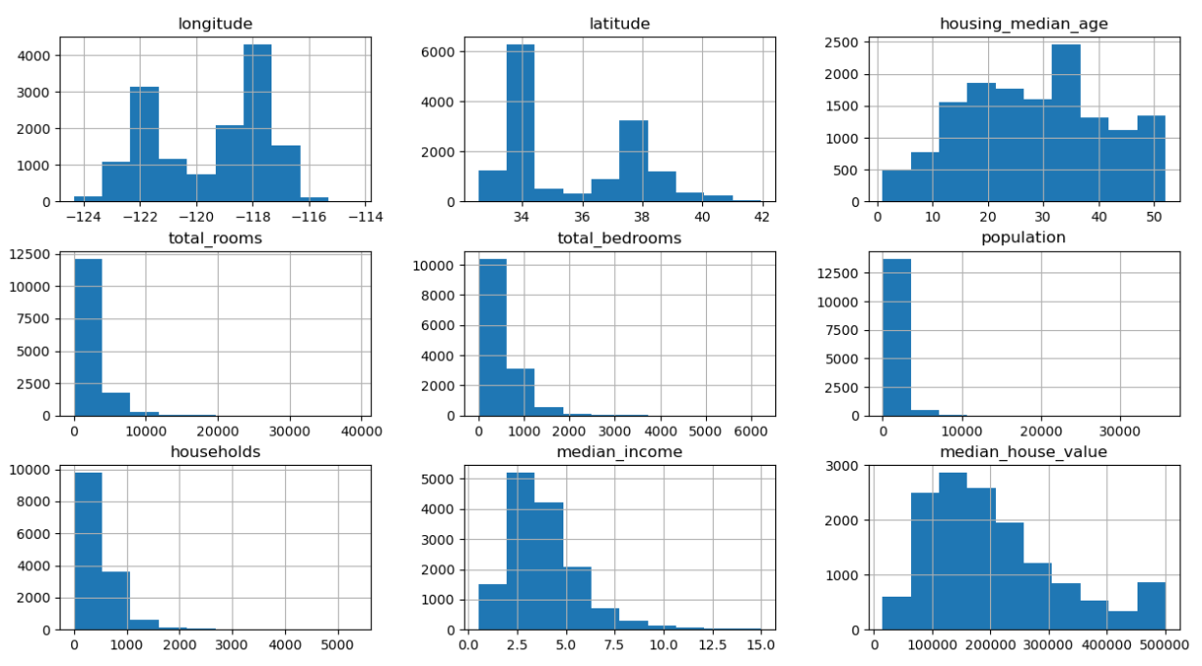
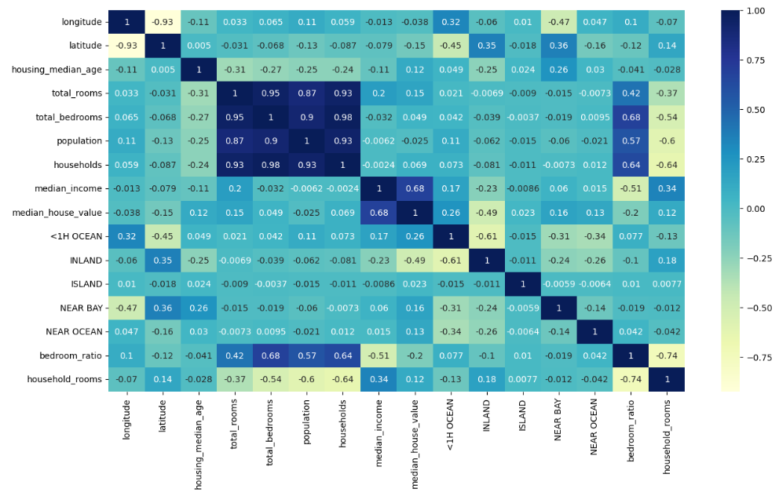
Exploring and Data Visualization
By using this code we can view the data values very nicely in one go data.hist(figsize=(15,8))
We also used Correlation practice to view each variable and its affect on the dataset. plt.figure(figsize=(15,8)) sns.heatmap(train_data.corr(),annot=True,cmap='YlGnBu')

Slide 7
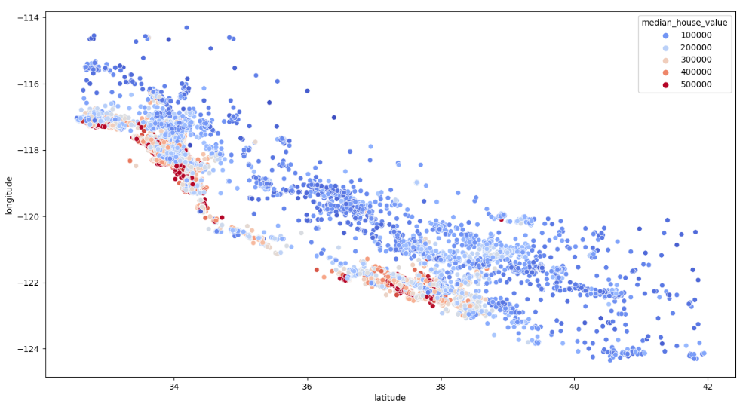
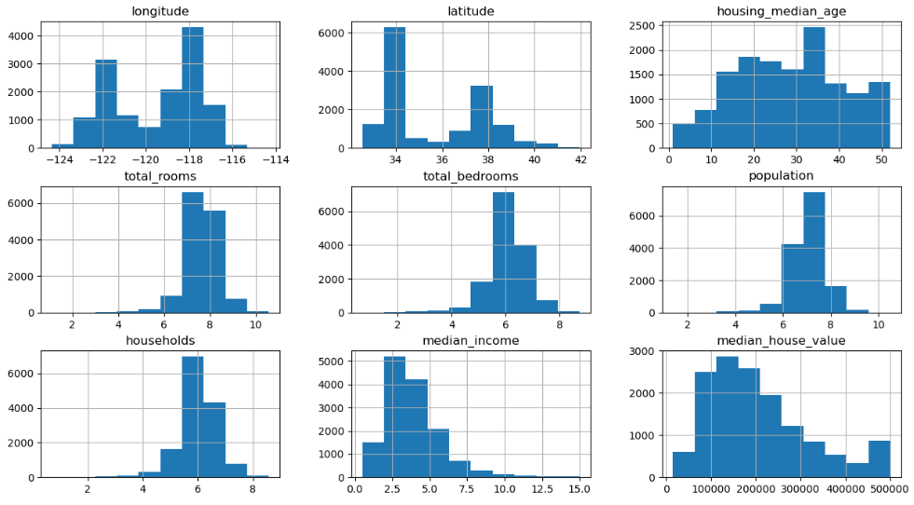
Exploring and Data Visualization
We used the below code to make the values better to validate and process the answer data['total_rooms'] = np.log(data['total_rooms']+1) data['total_bedrooms'] = np.log(data['total_bedrooms']+1) data['population'] = np.log(data['population']+1) data['households'] = np.log(data['households']+1) data.hist(figsize=(15,8))
We used this type of mapping and made use of the longitude parameter given to us in the dataset plt.figure(figsize=(15,8)) sns.scatterplot(x='latitude',y='longitude',data=train_data,hue='median_house_value',palette='coolwarm')

Slide 8
Data Modeling
We split the data into train data and test data using train_test_split
X_train, X_test, y_train, y_test = train_test_split(X, y, test_size = 0.3)
Then we used StandardScaler() to make the test cases better for the algorithm and to produce better results
scaler = StandardScaler() X_train_s = scaler.fit_transform(X_train) X_test_s = scaler.transform(X_test)

Slide 9
Data Modeling
We used many models here to find the best result.
Linear Regression
Random Forest Regressor
Ridge Model
Bayesian Ridge Regression Model
Lasso Regression
Decision Tree Regression
LARS Lasso (Least Angle Regression)
SVM Regression

Slide 10
Data Modeling
Best Results:
Linear Regression - 0.671749518099279
Random Forest Regressor - 0.8115075872469429
Ridge Model - 0.67388791638687
Bayesian Ridge Regression Model - 0.674080371587382
Lasso Regression - 0.6740356857956942
Decision Tree Regression - 0.6083402157148982
LARS Lasso (Least Angle Regression) - 0.6737872514367259
SVM Regression - 0.6440757590338864
Out of these the best result was produced by the Random Forest Regression Algorithm.
Train : 0.8903103840205111 Test: 0.8115075872469429

Slide 11
Model Optimization
To all those whose score was above 0.65, I applied Model Optimization in hope that they would give better results.
I used GridSearchCV and then used k – fold Validation
I also used RandomizedSearchCV in some cases.
The results of all the models I used was almost same.
The only significant difference was in the Random Forest Regression Algorithm.

Slide 12
Model Optimization
Best results:
Linear Regression - 0.671749518099279
Random Forest Regressor - 0.8270307874139204
Ridge Model - 0.6739923327774847
Bayesian Ridge Regression Model - 0.6740803715873782
Lasso Regression - 0.6740273787505616
Decision Tree Regression - 0.7202689738495702
LARS Lasso (Least Angle Regression) - 0.6738267201478304
SVM Regression - 0.47002134422253283
Out of these, the best result was produced by the Random Forest Regression Algorithm.
Train => 0.9031038402051115 Test => 0.8270307874139204
After K – fold validation:
Train: 0.8019265085868289 Test: 0.7843897759971274

Slide 13
Model Optimization
K – fold Validation results:
Linear Regression - 0.671749518099279
Random Forest Regressor - 0.7843897759971274
Ridge Model - 0.6674200238179211
Bayesian Ridge Regression Model - 0.6674320479813023
Lasso Regression - 0.6673850329705481
Decision Tree Regression - 0.6770904079532085
LARS Lasso (Least Angle Regression) - 0.6673803396473966
SVM Regression - 0.42299638253044736
Out of these, the best result was produced by the Random Forest Regression Algorithm.
Train => 0.9031038402051115 Test => 0.8270307874139204
After K – fold validation:
Train: 0.8019265085868289 Test: 0.7843897759971274

